Slide 1
Project Presentation
Ehsan

Slide 2
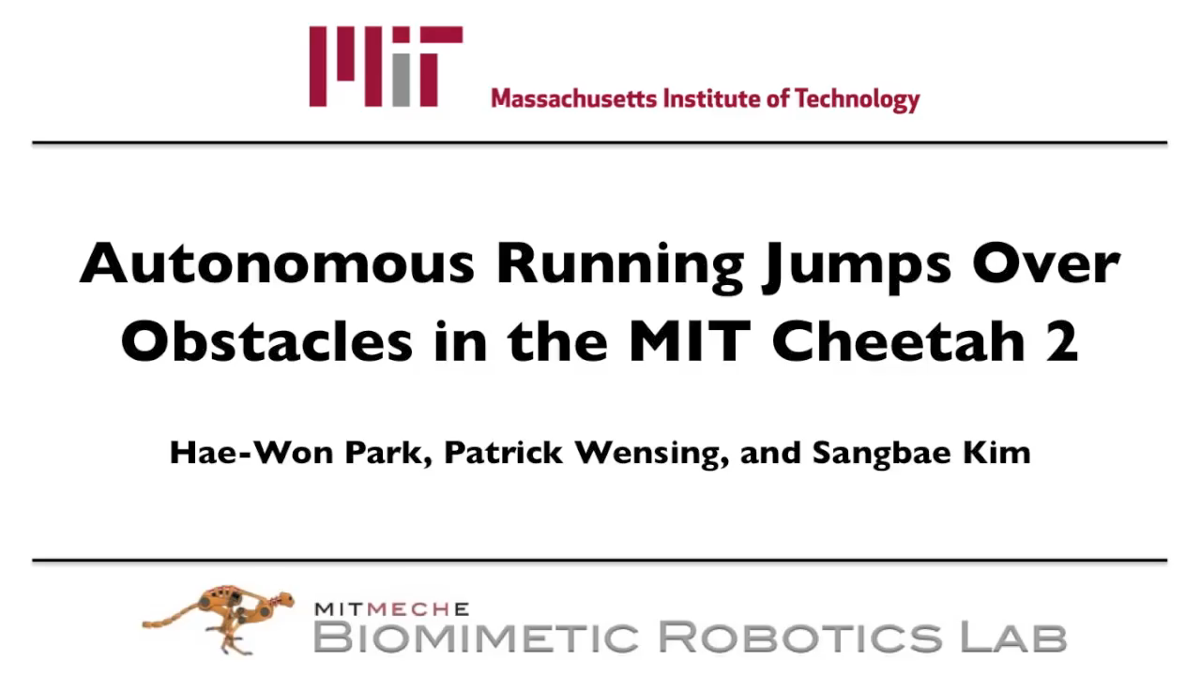
Review: Cheetah Video

Slide 3
Review: Takeaway message
A generalizable learning methodology needs to be integrated in such robots!

Slide 4
Project Proposal
Project Description:
Simulating a 1-legged robot, and controlling it using RL.
Simulation Details:
Simulation Physics Engine: Bullet
API : PyBullet
Implementation:
Algorithm: PPO
Target:
avoiding a moving obstacle on a conveyer belt

Slide 5
Challenges
The first challenge was to set up the simulator properly.
Setting the friction coefficients properly was a challenge.
Motors should be deactivated and then used properly.
Robot description should be very precise.
…

Slide 6
Challenges
Reward shaping was also an important challenge.
The potential energy is the first shot
However, it is unstable.
The motor energy consumption could help in stabilization
However, the robot could lean on itself for avoiding energy consumption.
Self and ground collision costs could help.
For robot safety, we would like it to respect some boundaries. For instance, learning not to cross some angular red lines.
Stall torque costs could also benefit in getting more energy-efficient and stable agent.
Angular displacement cost, could discipline the legs.

Slide 7
Reward Shaping: Types of issues
Policy Optimization problems
Unwanted semi-optimal agent behaviors
You really need to recognize the type of issue.
Each has its own cures. You should not confuse the two.
You may end up alternating between the two.

Slide 8
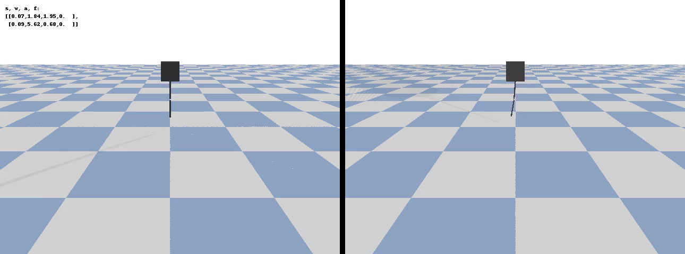
Standing video

Slide 9
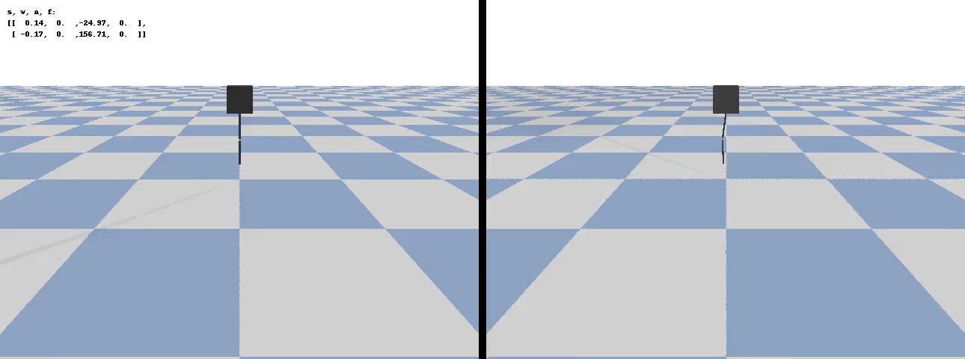
Obstacle avoidance

Slide 10
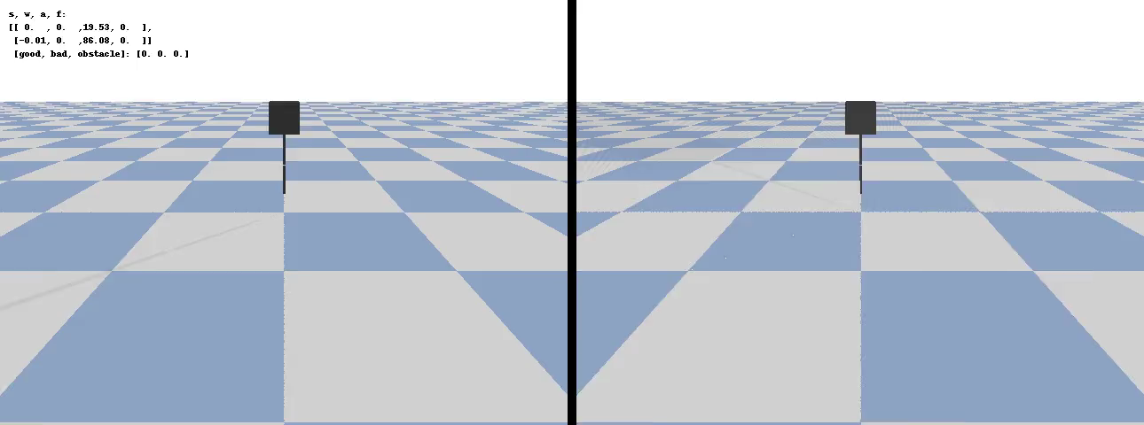
Obstacle avoidance

Slide 11
Future Work
Hardware implementation of the Simulation-Learned policy
Making sure that the controller would not harm the device
Hardware online learning
Reducing sample complexity

Slide 12
References
Hae-Won Park, Patrick M Wensing, and Sangbae Kim, “High-speed bounding with the MIT Cheetah 2: Control design and experiments,” The International Journal of Robotics Research, vol. 36, no. 2, Feb. 2017.
Schulman, J., Wolski, F., Dhariwal, P., Radford, A. and Klimov, O., 2017. Proximal policy optimization algorithms. arXiv preprint arXiv:1707.06347.

Slide 13
Questions?

Slide 14
Thank you

